Slide 1
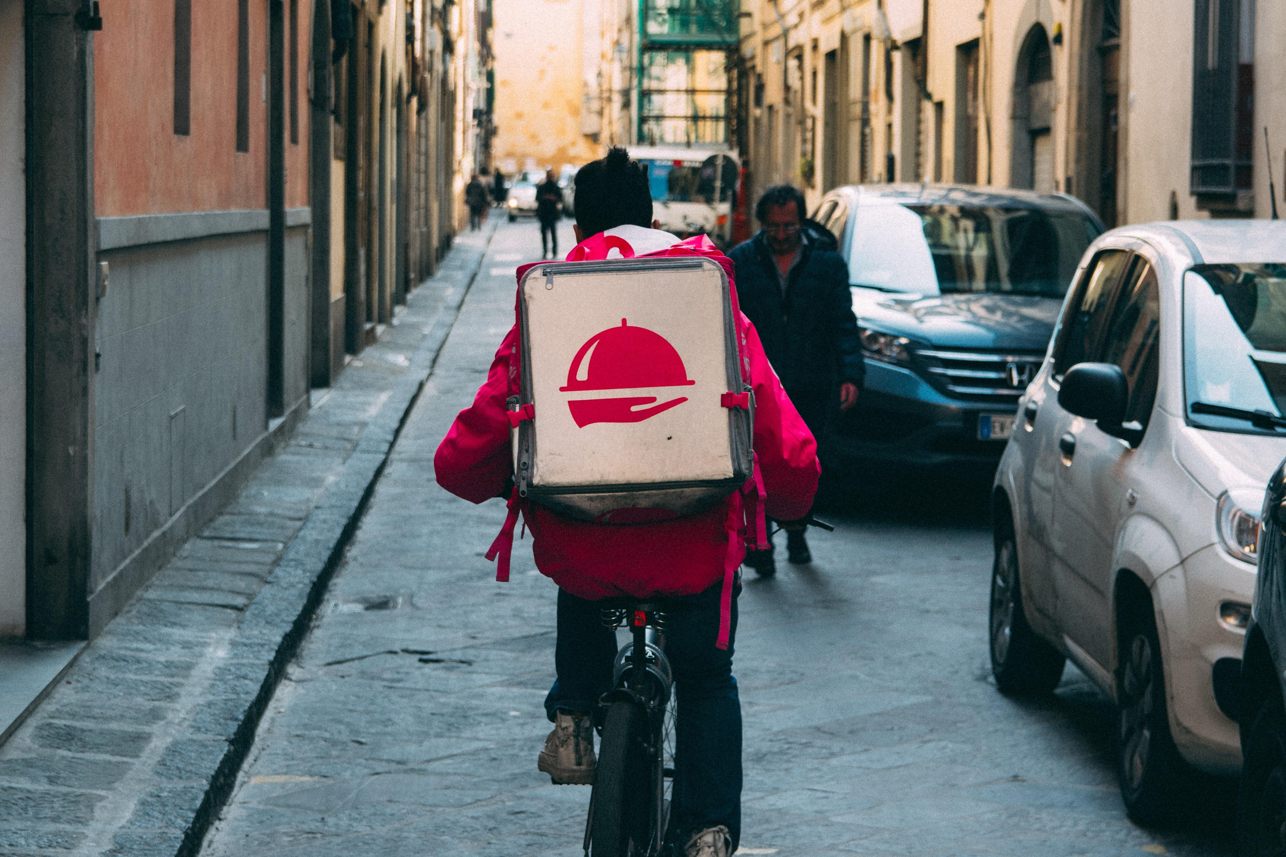

Cancanneed
Liu Xianhao、Zhang Zhenkun、Pan Jiajun、Lu Yu

Slide 2
CONTENT
It records our thinking process and design practice.
Background
Research
Why should I use Eyecompass service?
Technical realization
Other expansion

Slide 3
01
Background

Slide 4
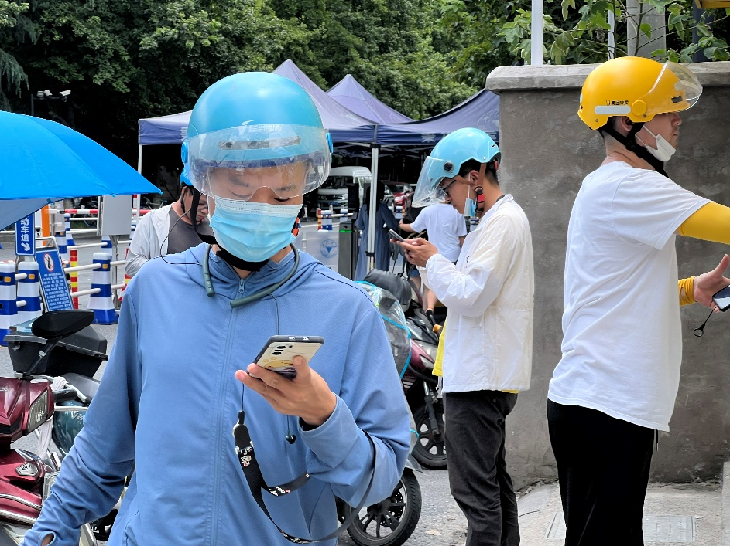
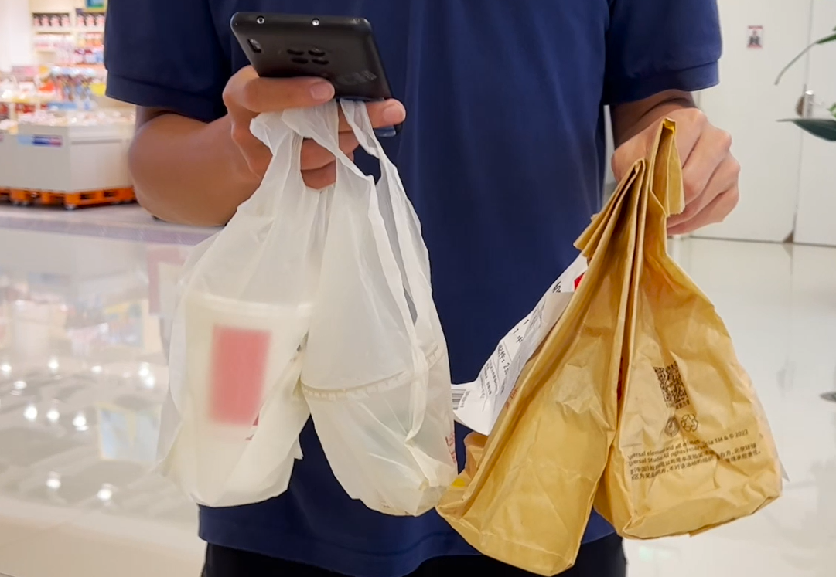
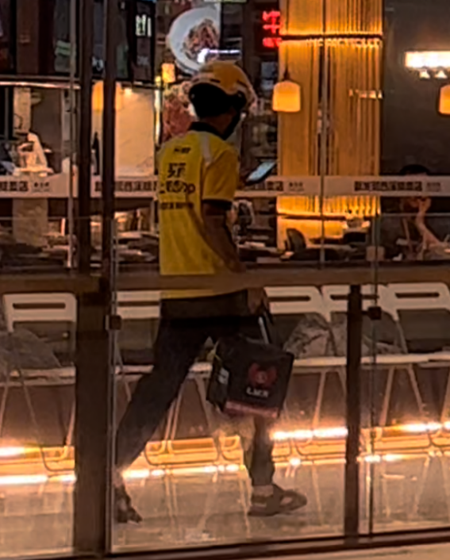
Pain point 1
Hands occupied

Slide 5
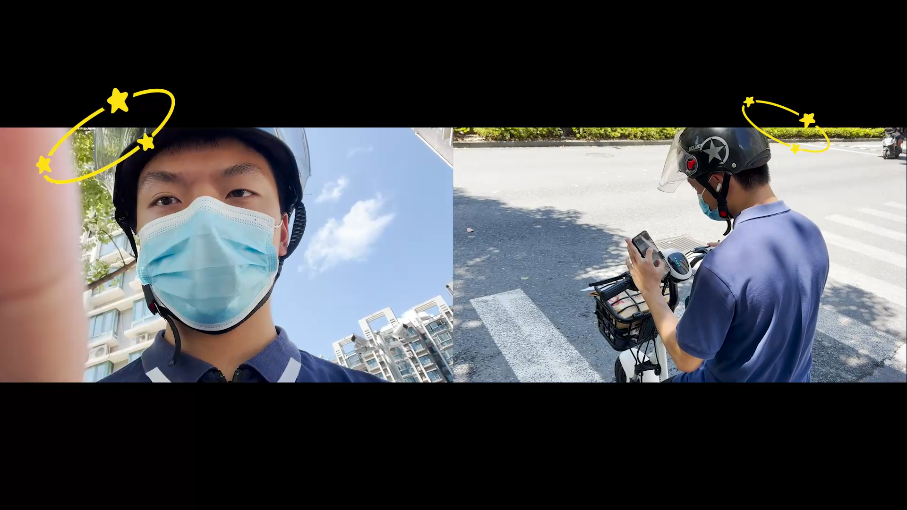
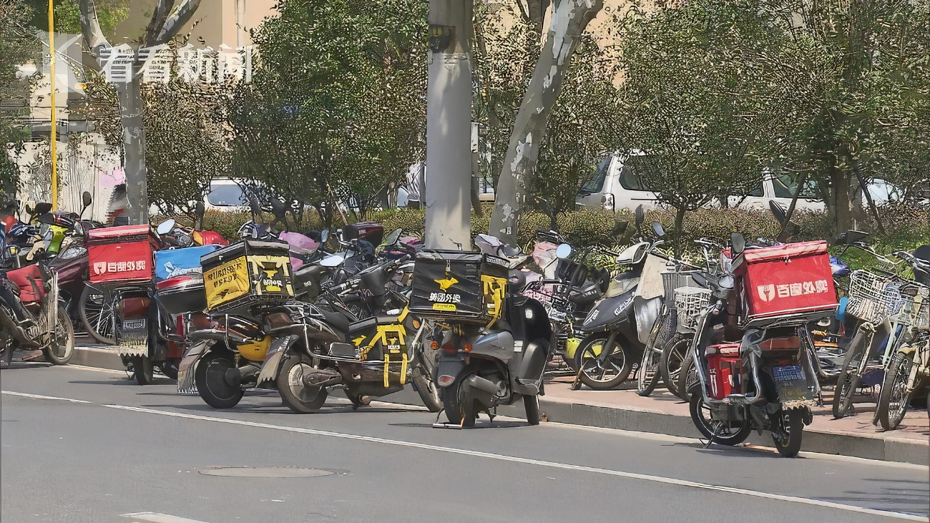
Pain point 2
Potential safety hazards

Slide 6
02
Research

Slide 7
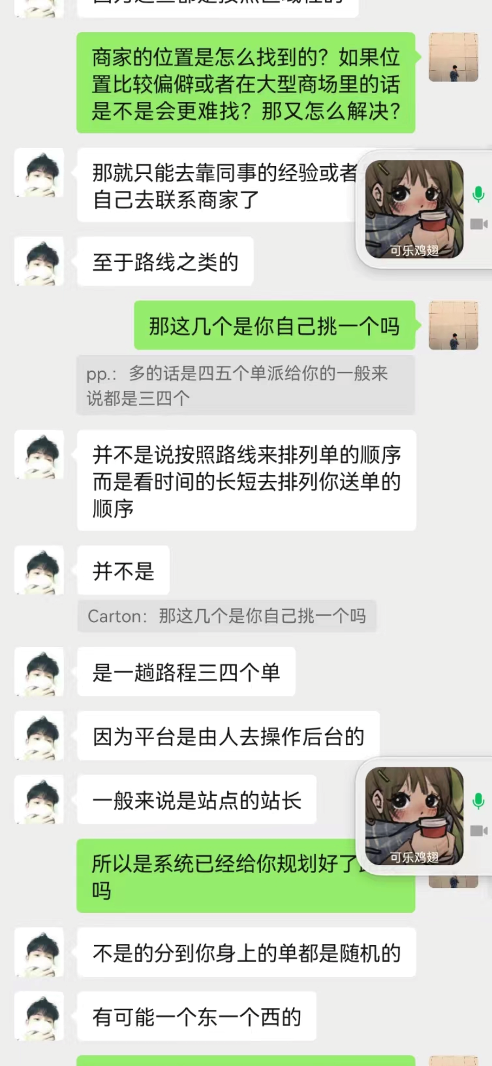
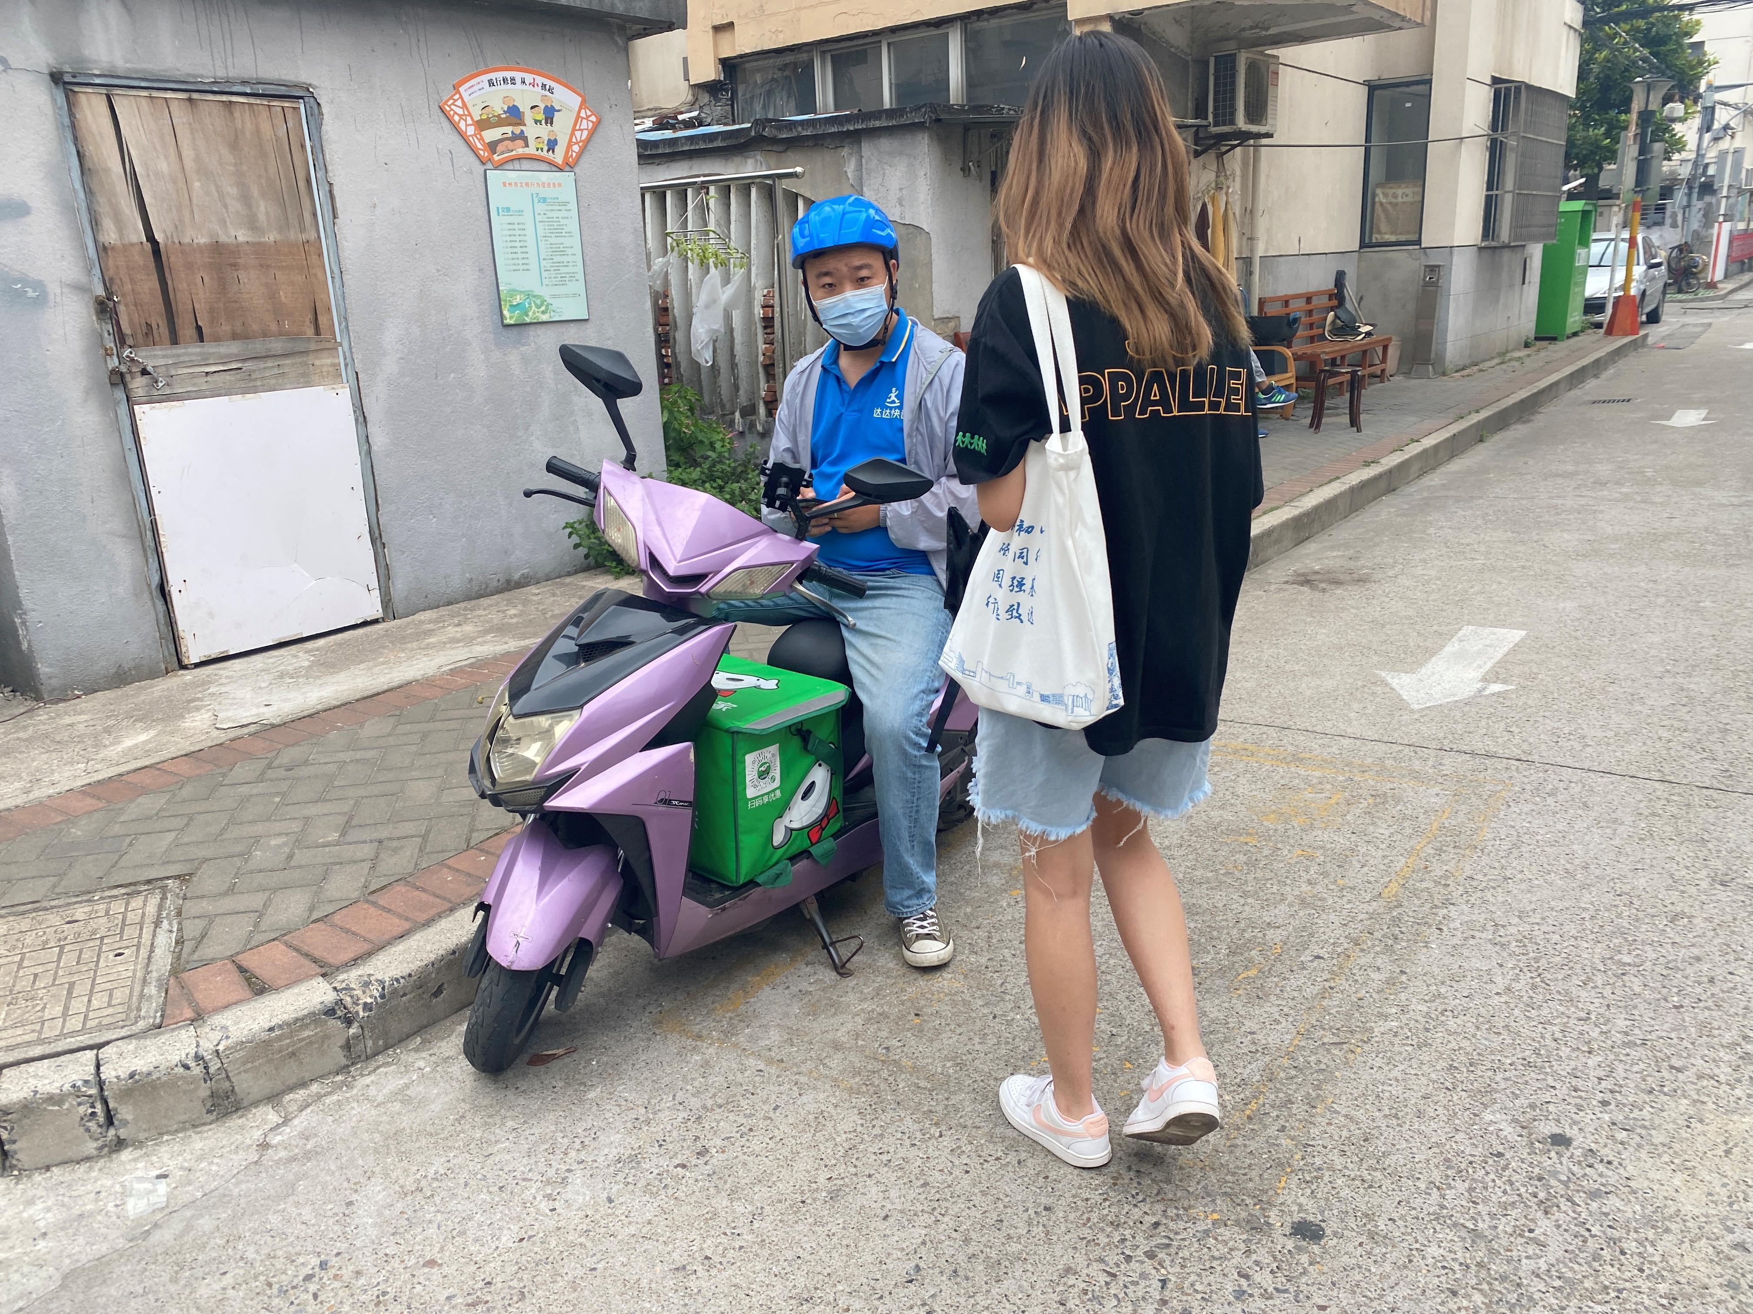
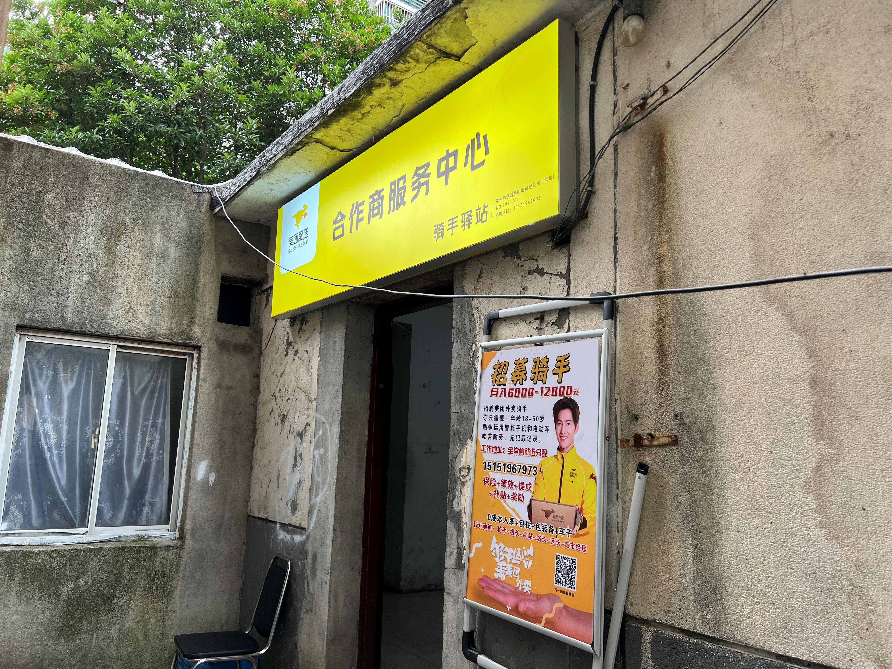
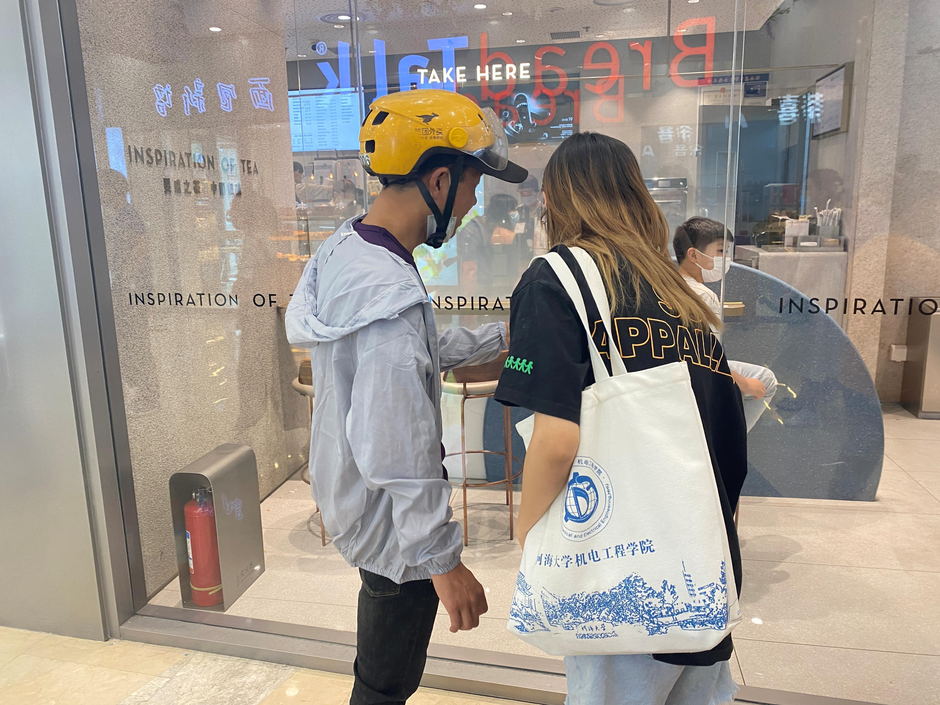
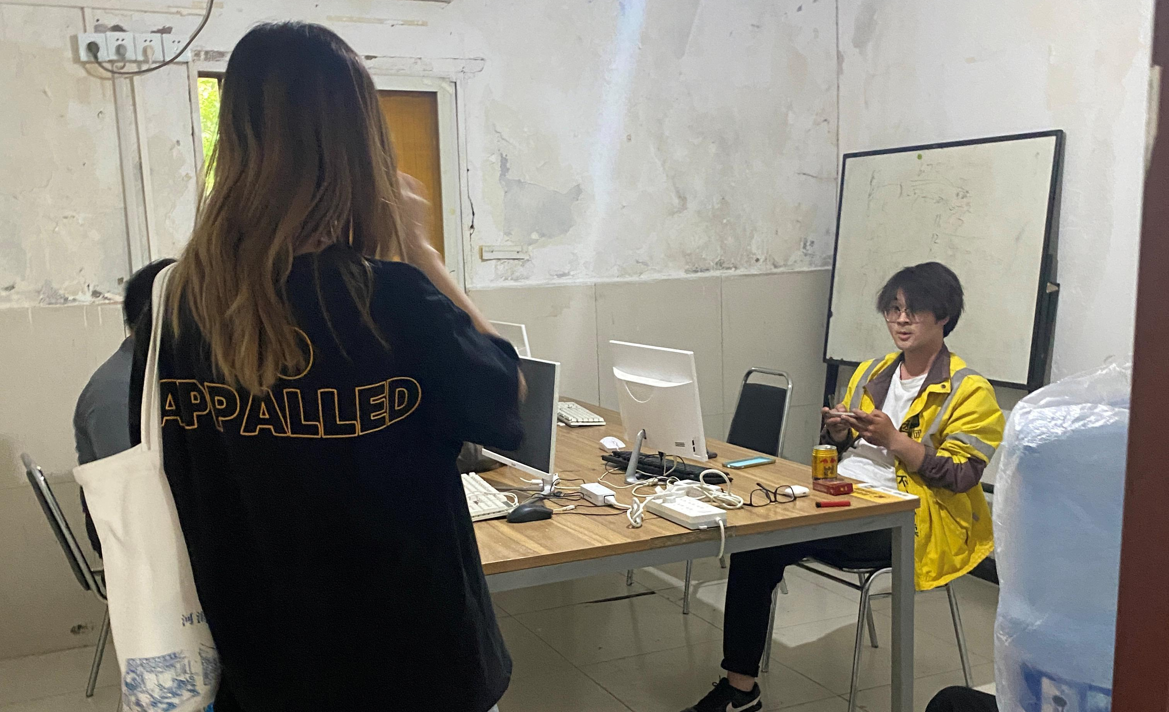



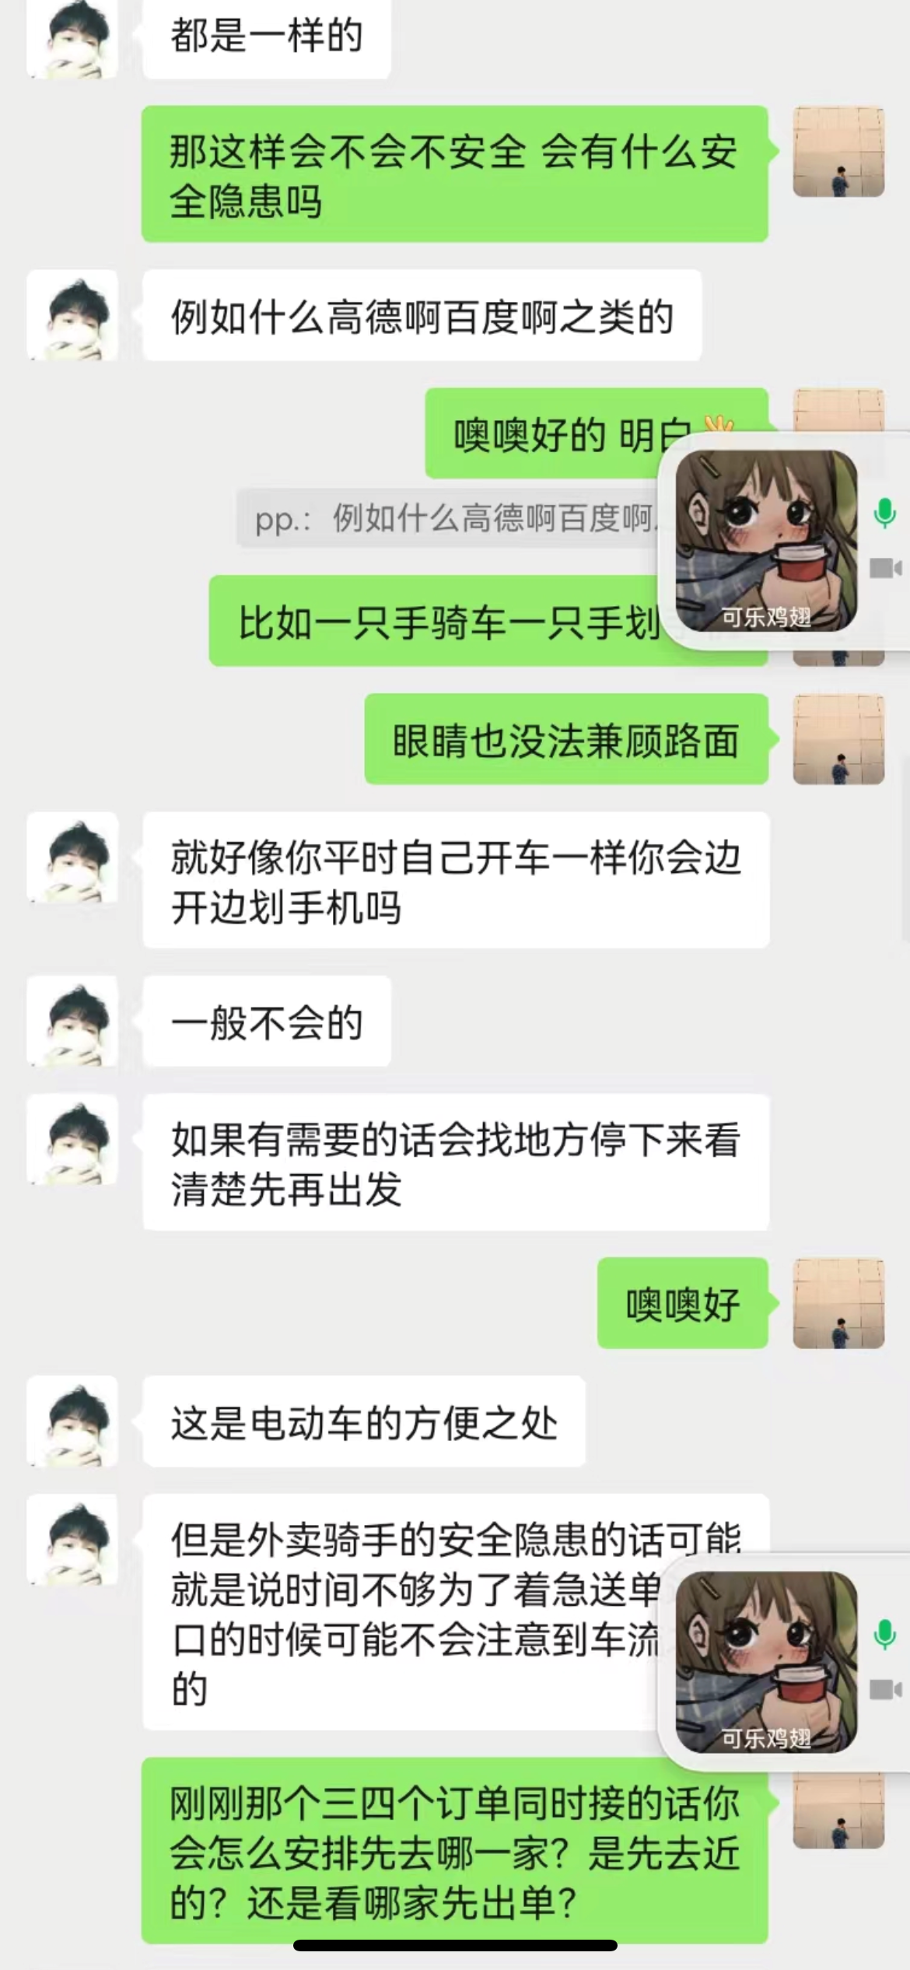
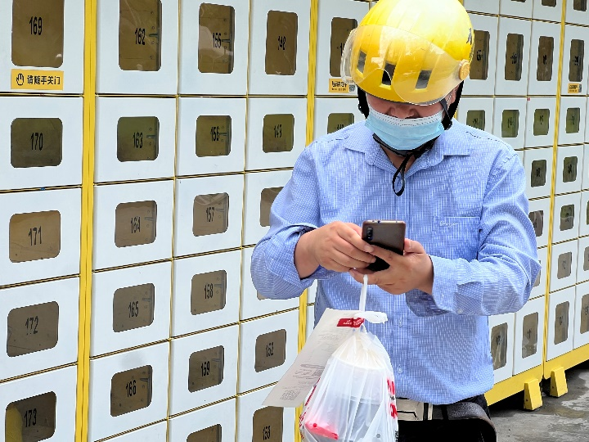

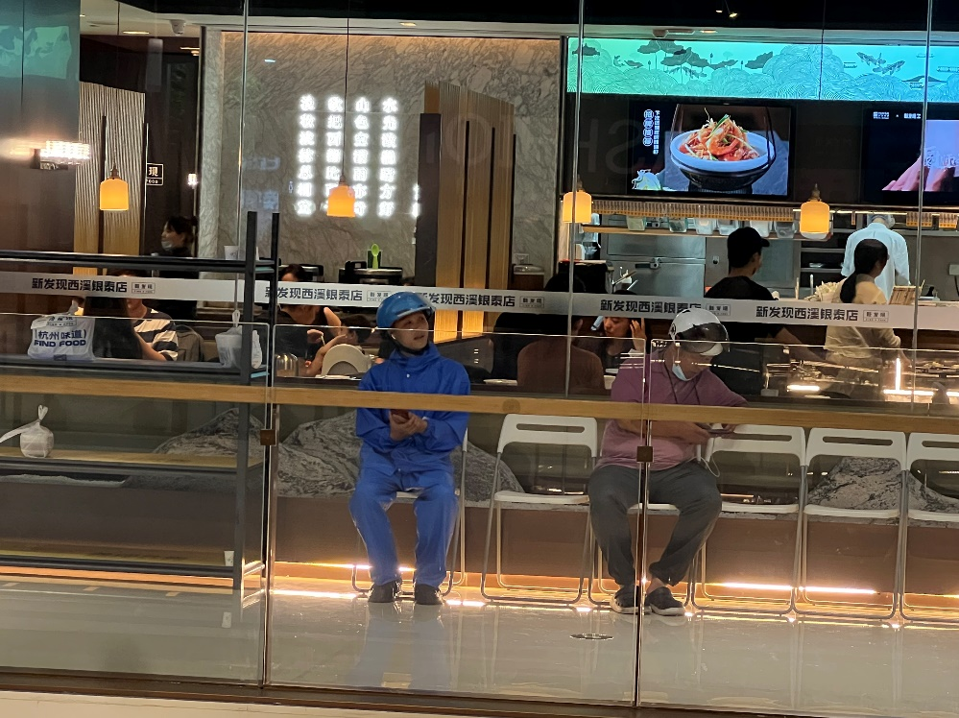
User
interview
Time and efficiency
Check phones frequently
Pass by when necessary

Slide 8
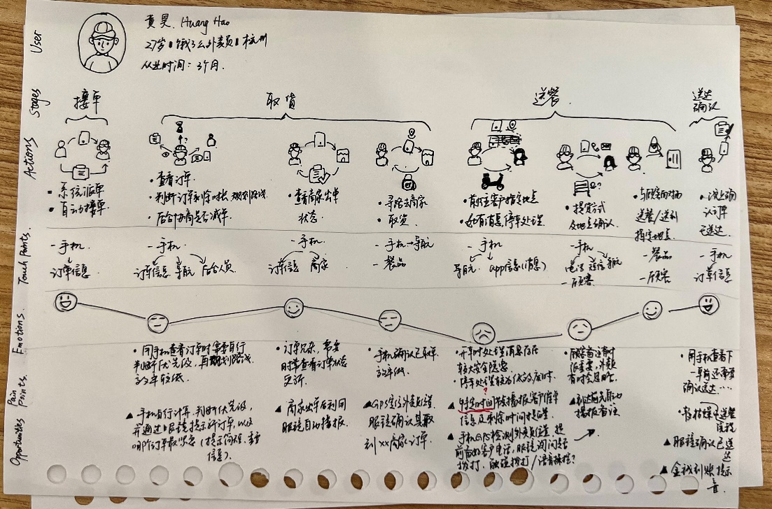
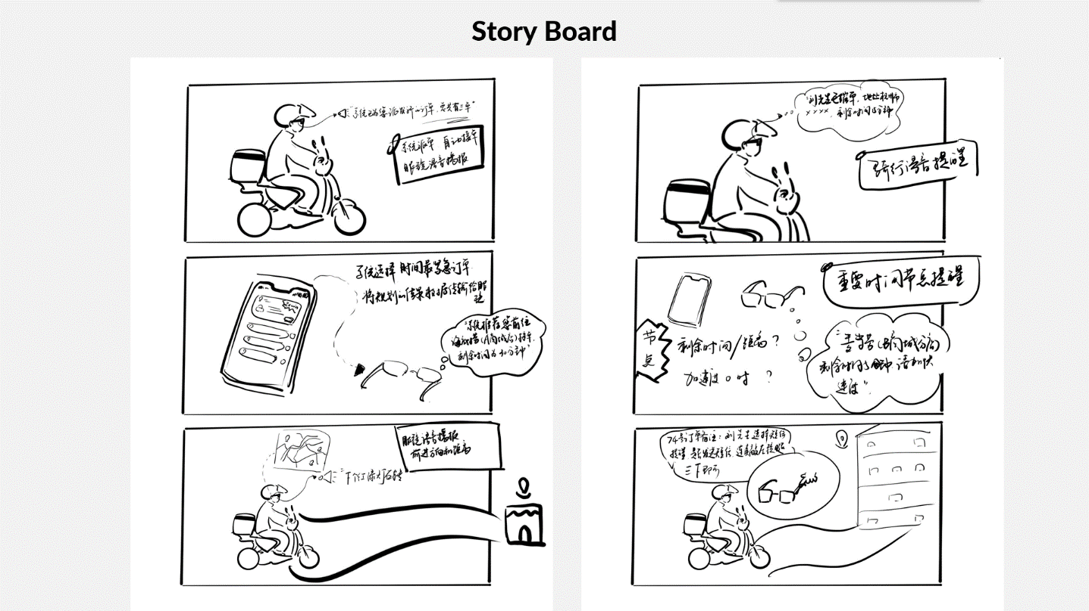
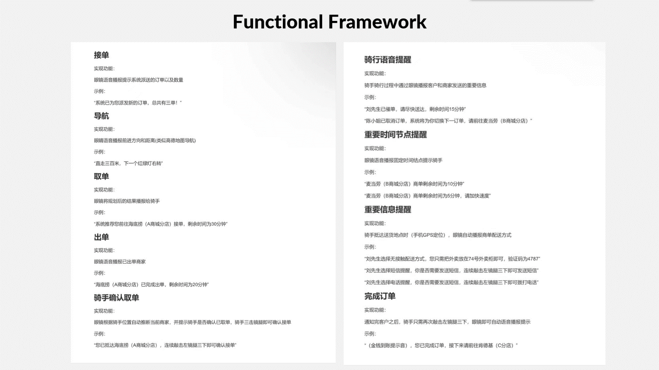
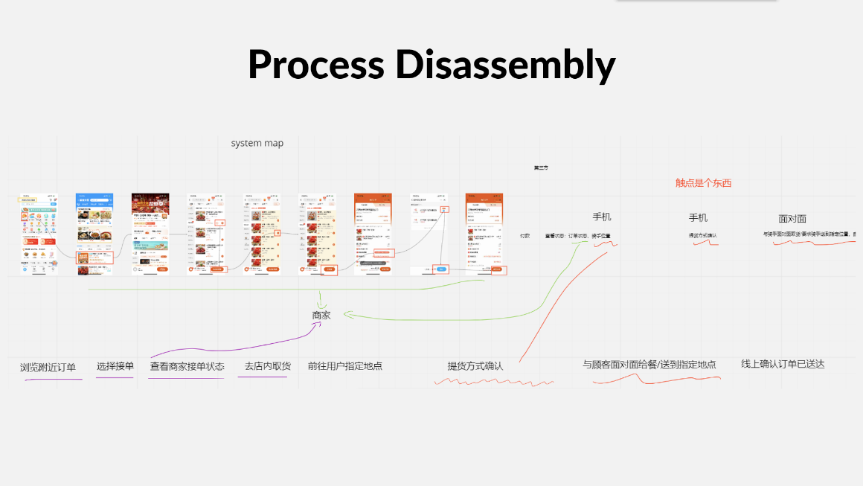
User journey map
Storyboard
Functional Framework
Process Disassembly

Slide 9
03
Why should I use Eyecompass service?

Slide 10




The orientation of the glasses is highly consistent with the eye line.
Heads-up computing

Slide 11
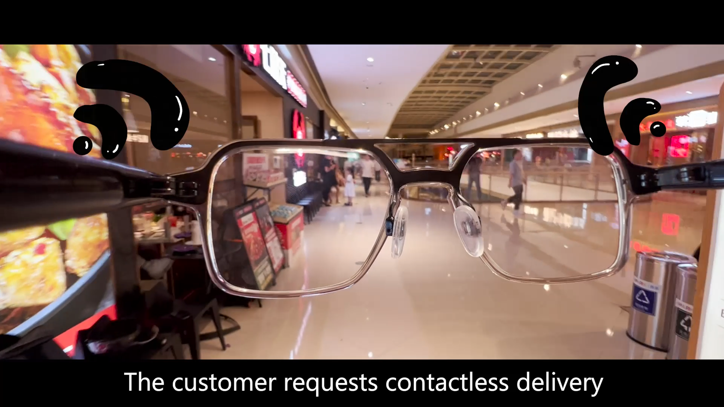
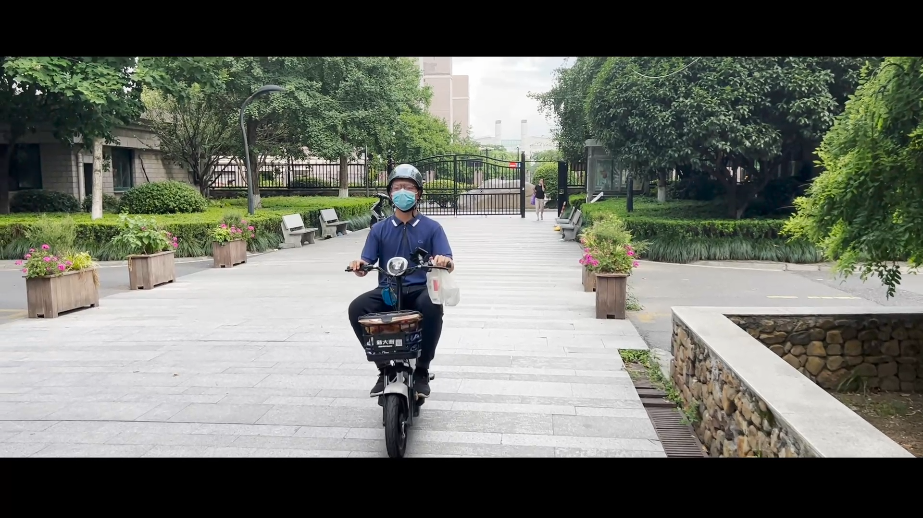
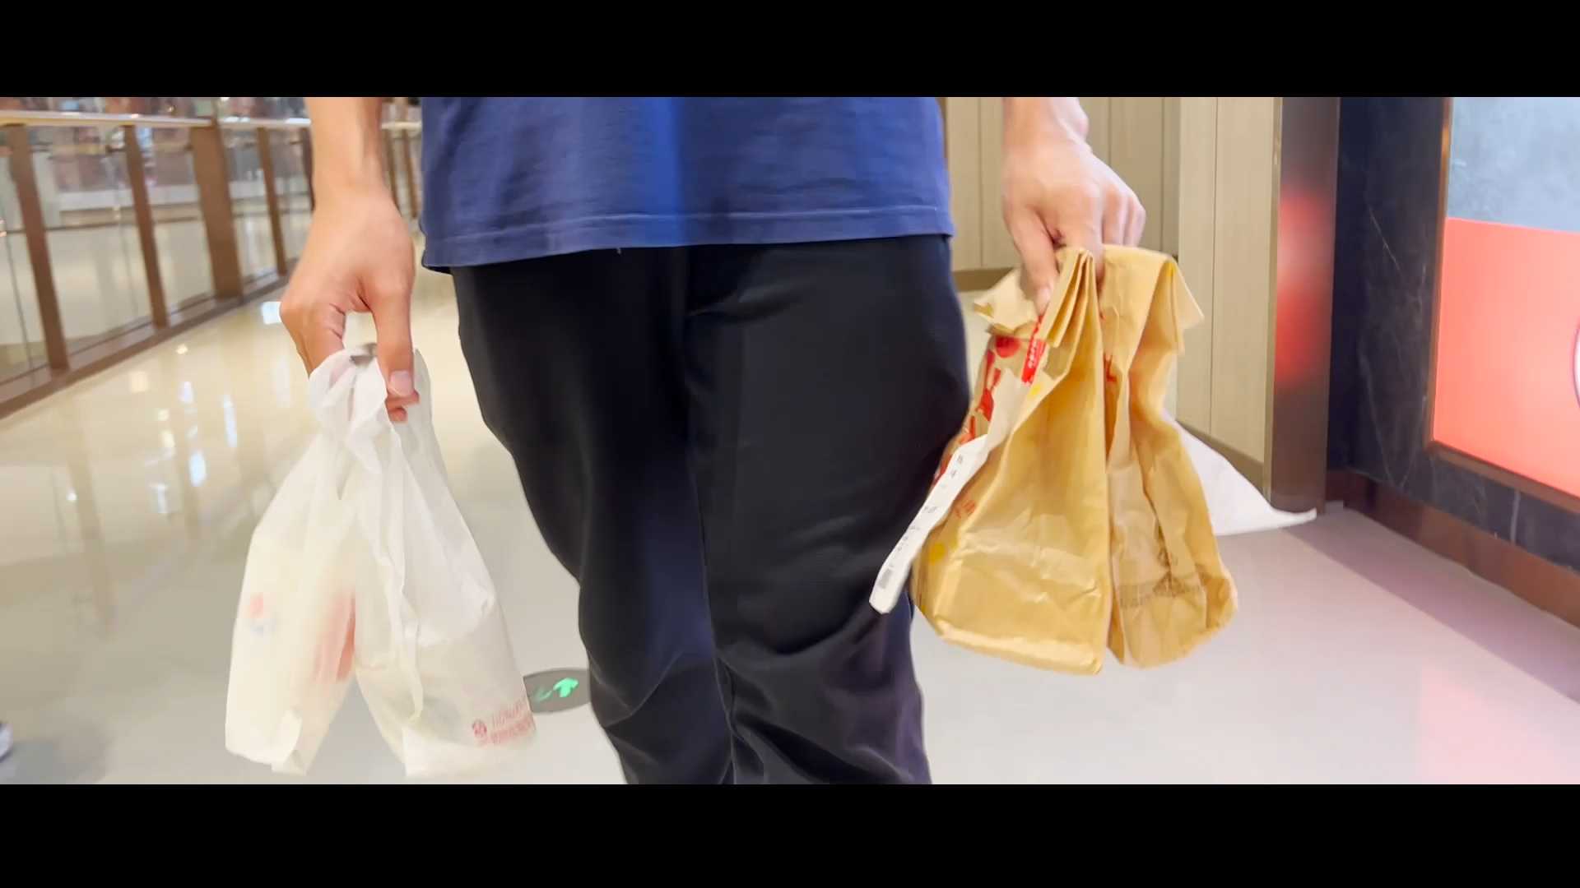
Deliverymen can use navigation with their hands free.

Slide 12
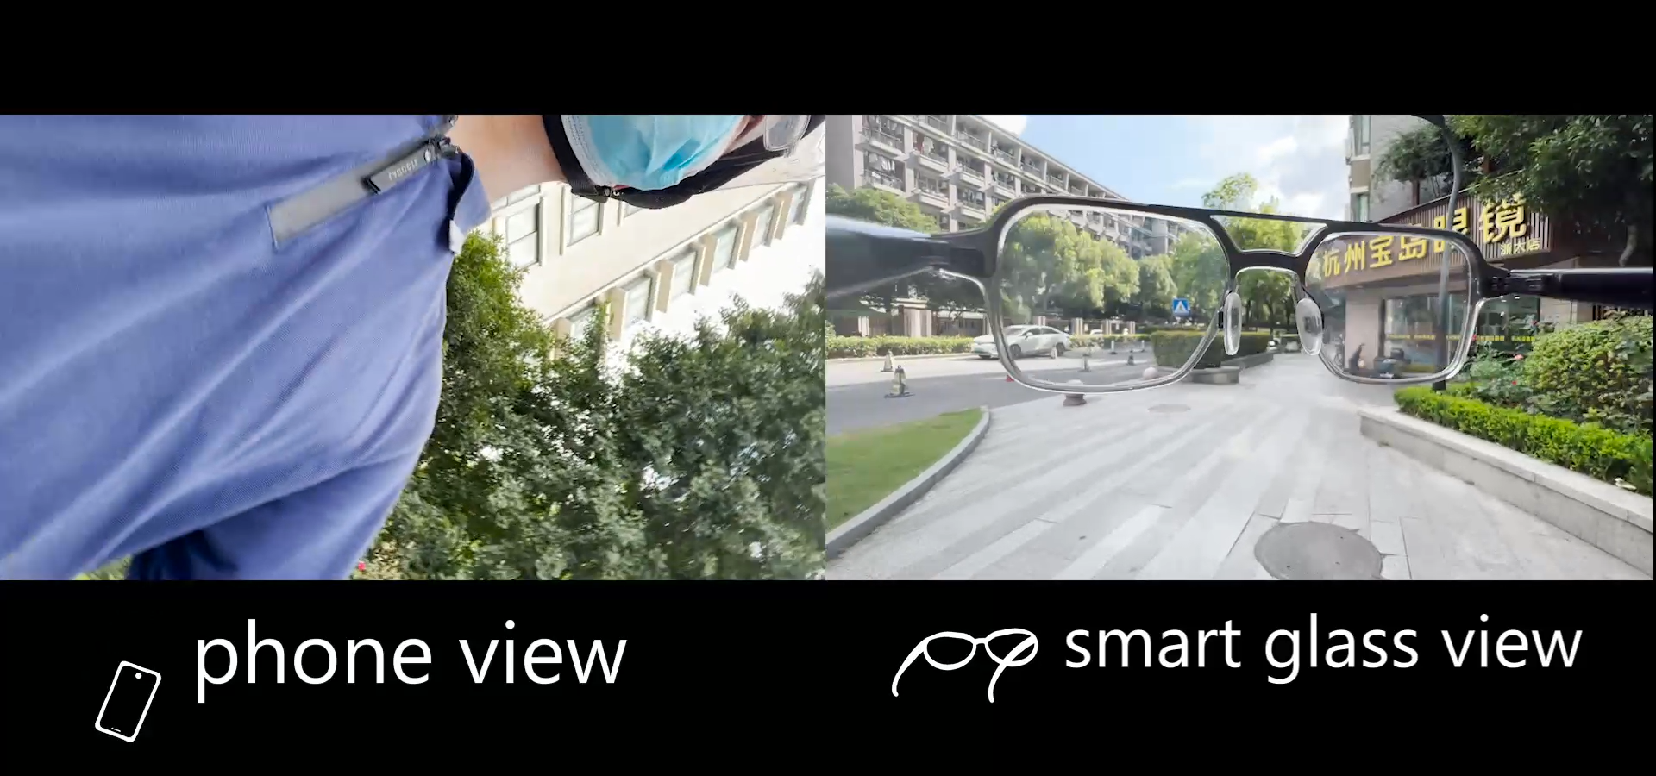


Navigating according to the glasses could make the delivery man's journey safer.

Slide 13
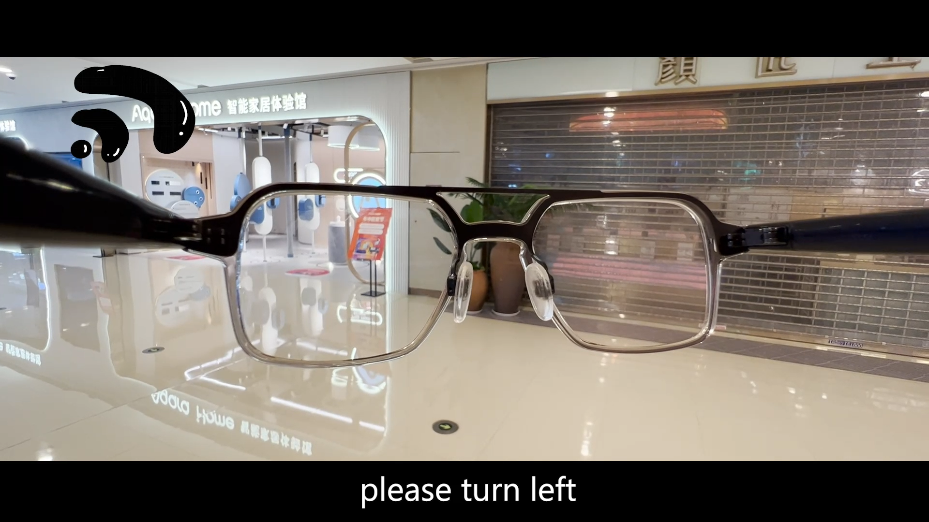
Dual sound channel contrast prompts steering.

Slide 14
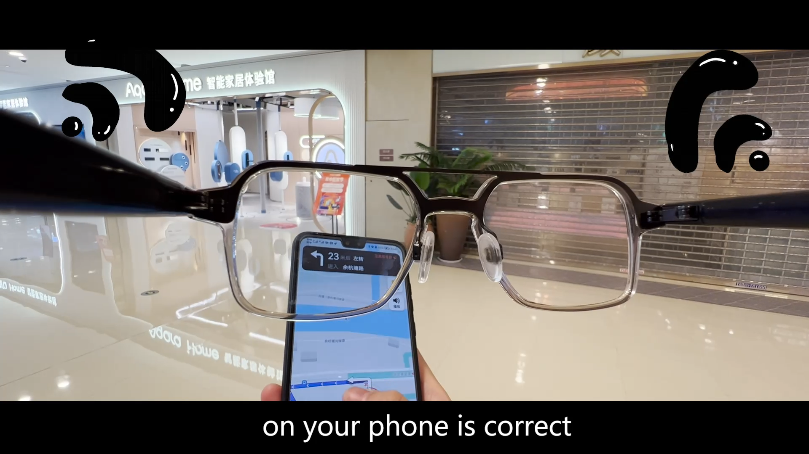
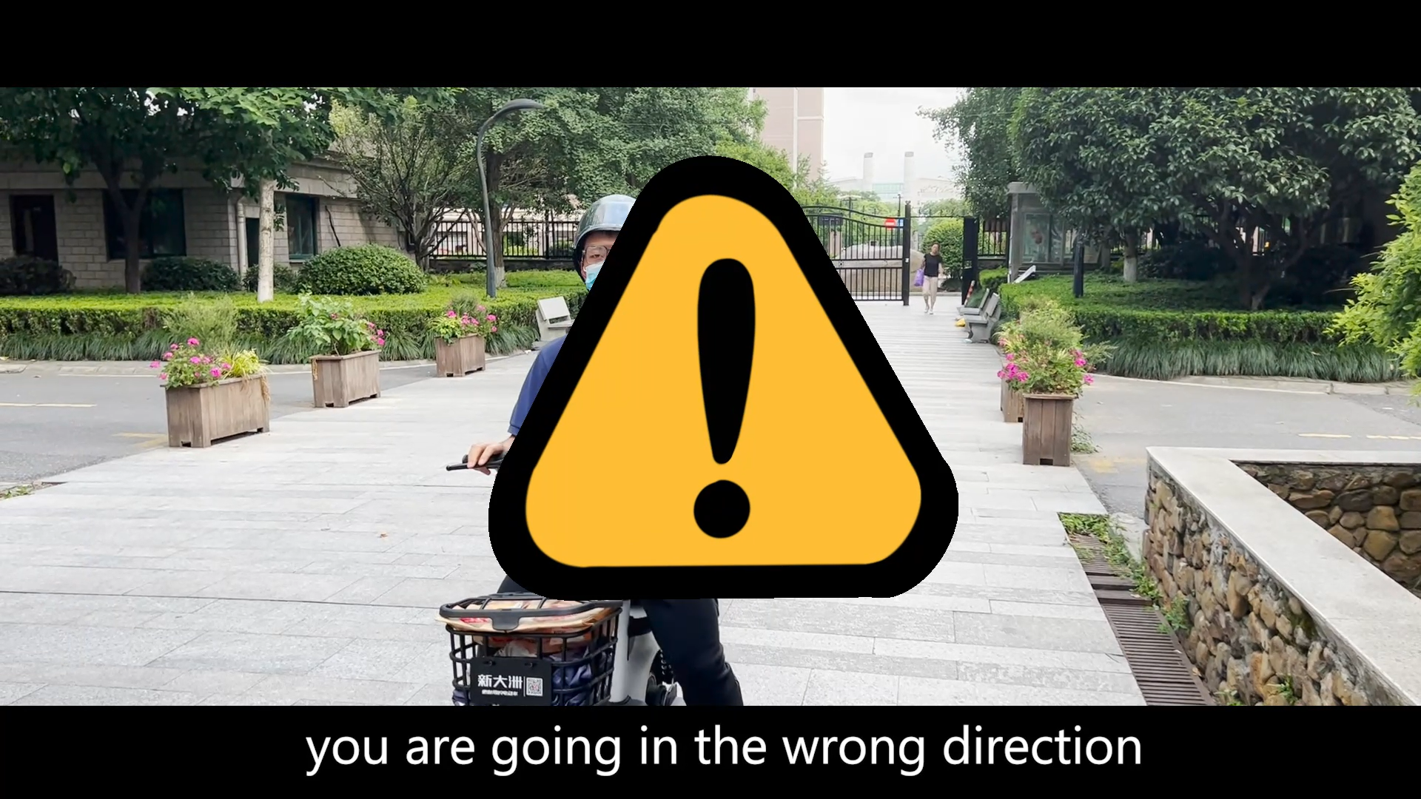
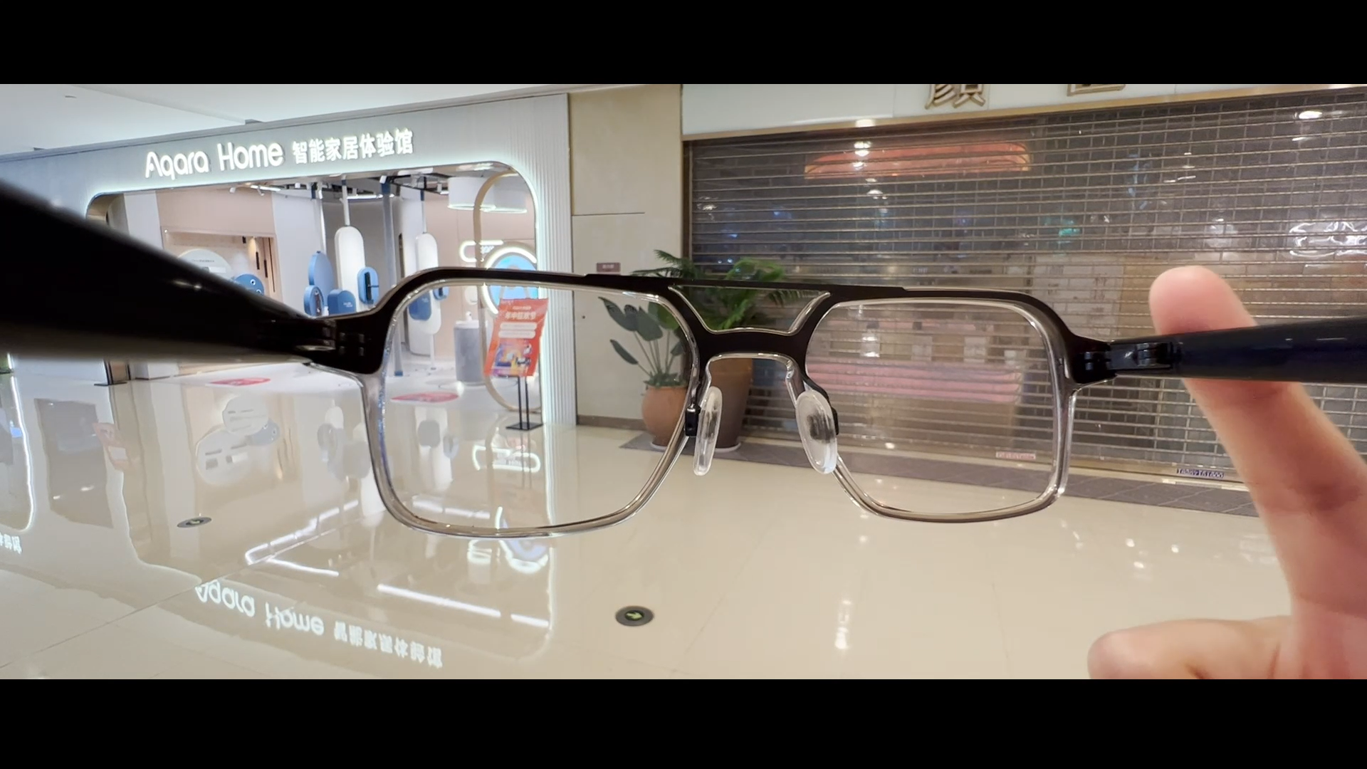
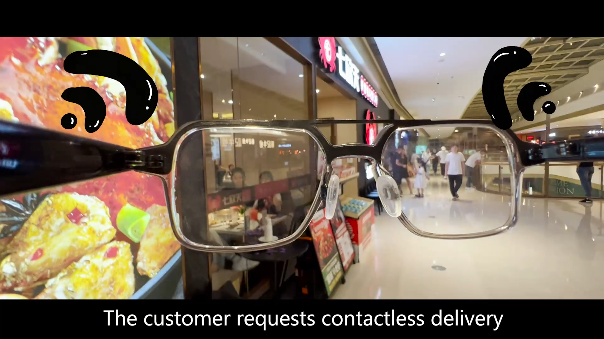
Reliability and fault tolerance.
Prompt confirmation route
Driving off course alert
Double-click on the mirror leg to start navigation
Reminders of nearby landmarks and user notes

Slide 15


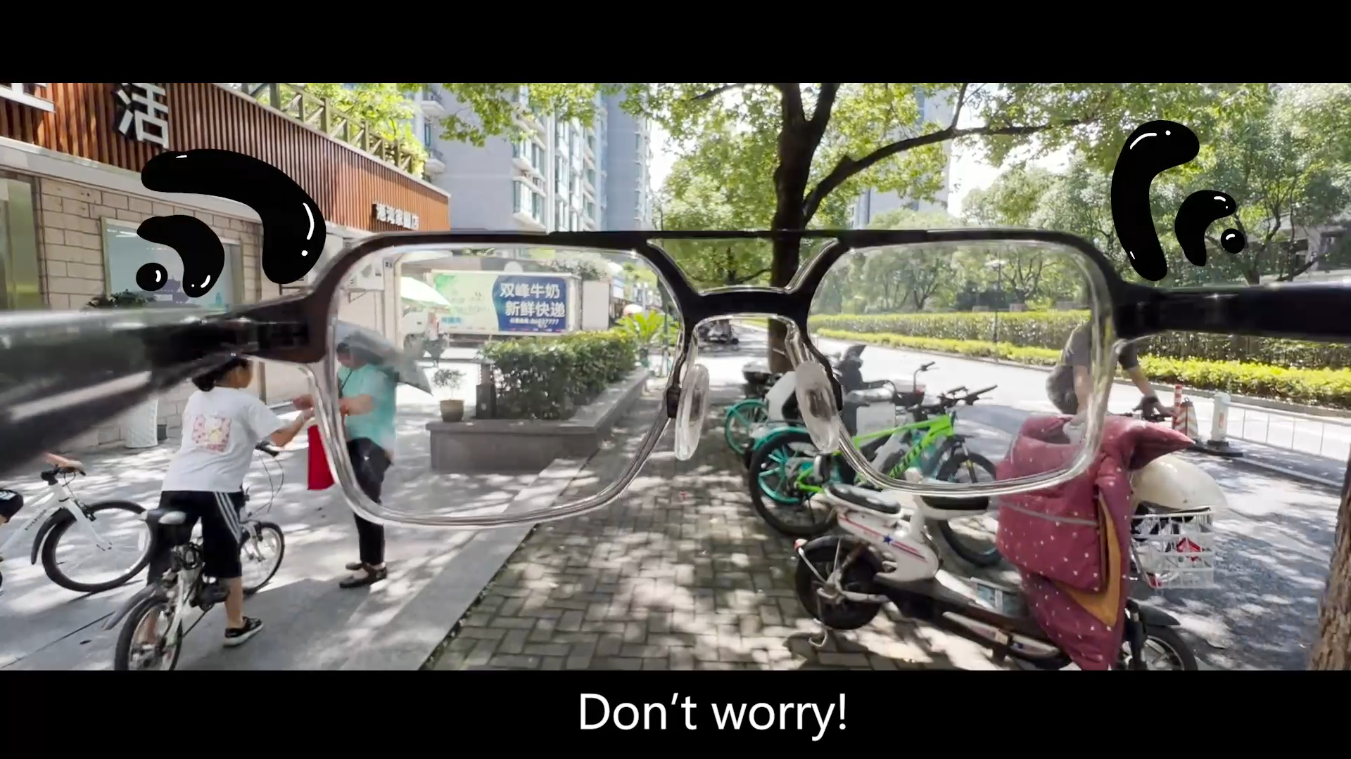
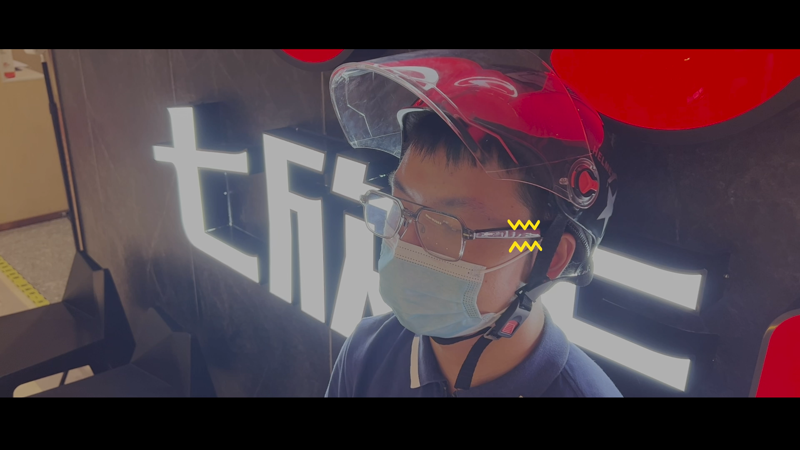
Humanistic care.
Gold drops sound provides a sense of accomplishment.
Remind that there is plenty of time left.
Rest reminders and vibration awakens on time

Slide 16
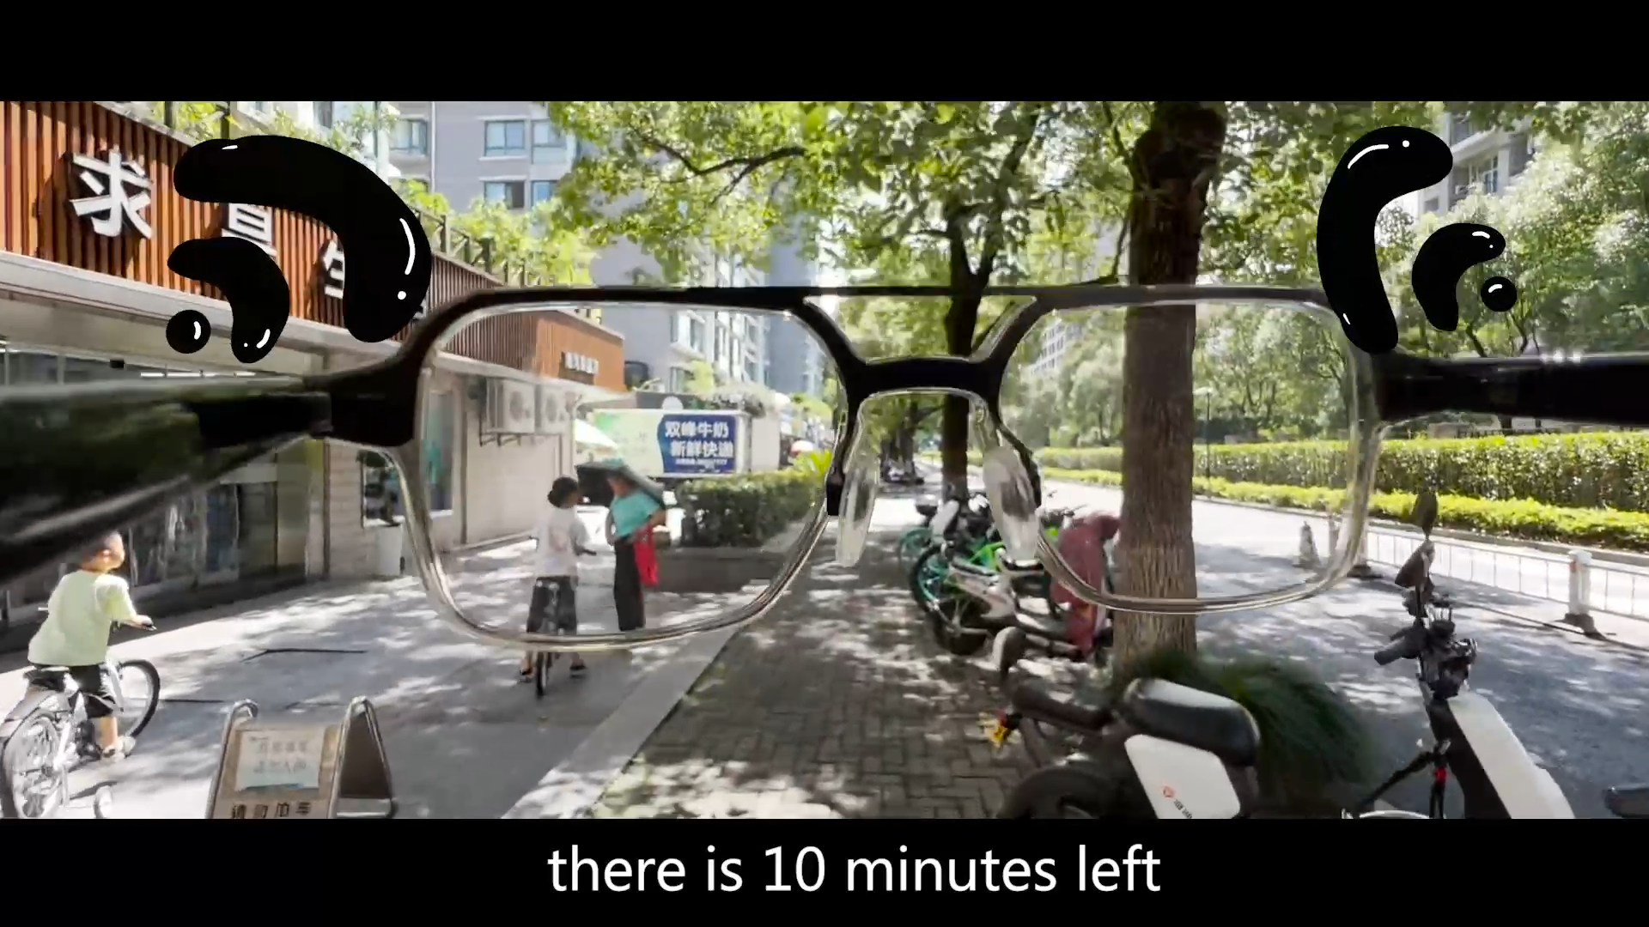
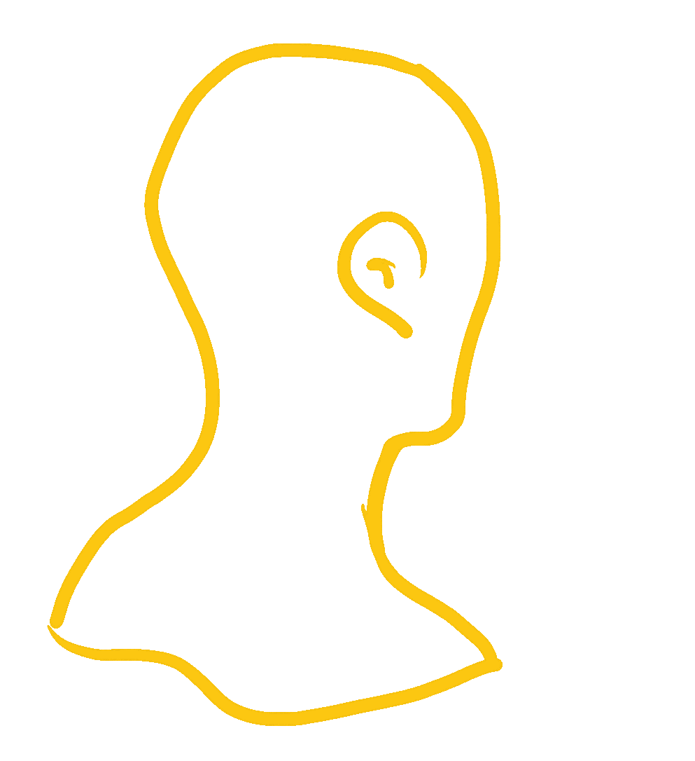
Multiple modes of interaction
Double-click on the mirror leg to start navigation
Nod to confirm remaining time
The vibration signals the end of the break.

Slide 17
04
Technical realization

Slide 18
Technical realization
double click to start navigation
detect orientation and give instructions
nod head to check left time
start up navigation in web and broadcast by glass

Slide 19
05
Other expansion

Slide 20
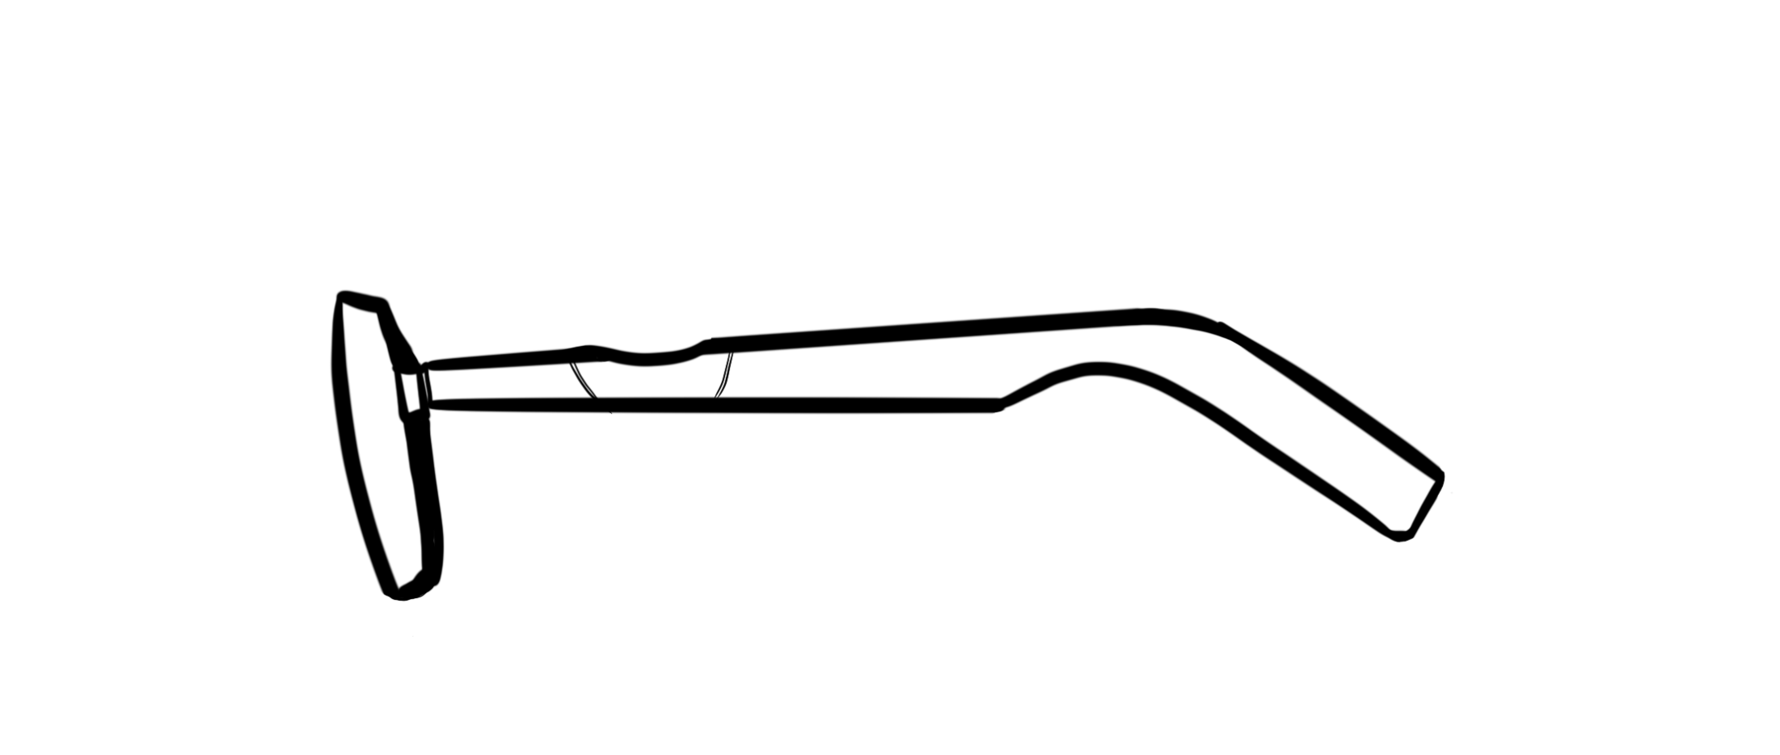
Hardware vision
A groove is added to the exterior shape to indicate that this is the position for pinching.
In terms of material update and effect feedback, we consider adding a press feedback when pinching down (similar to the effect of button pressing and bouncing up), accompanied by a clear and brief press prompt sound.
Is it feasible to add a vibration module to the mirror leg?

Slide 21
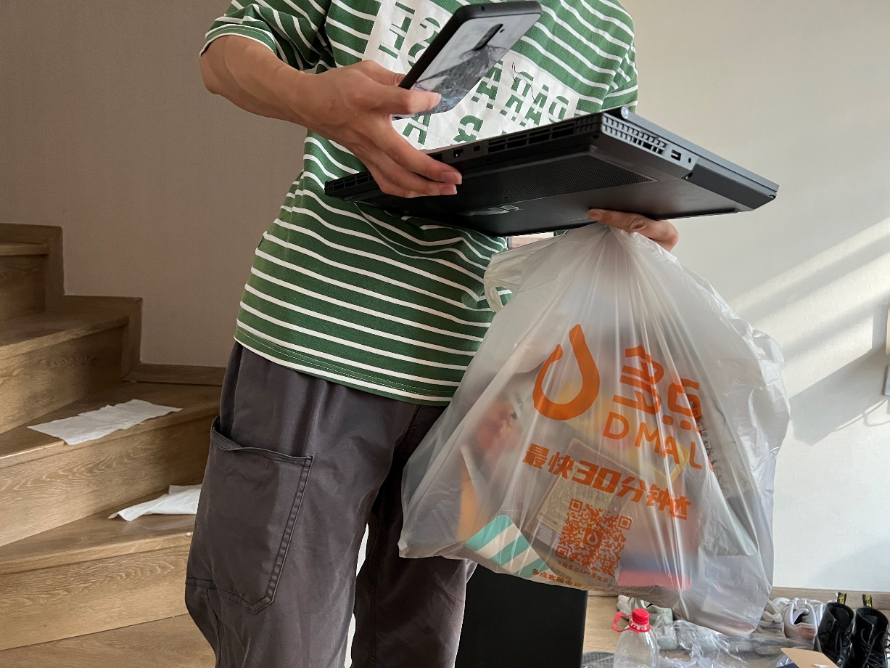
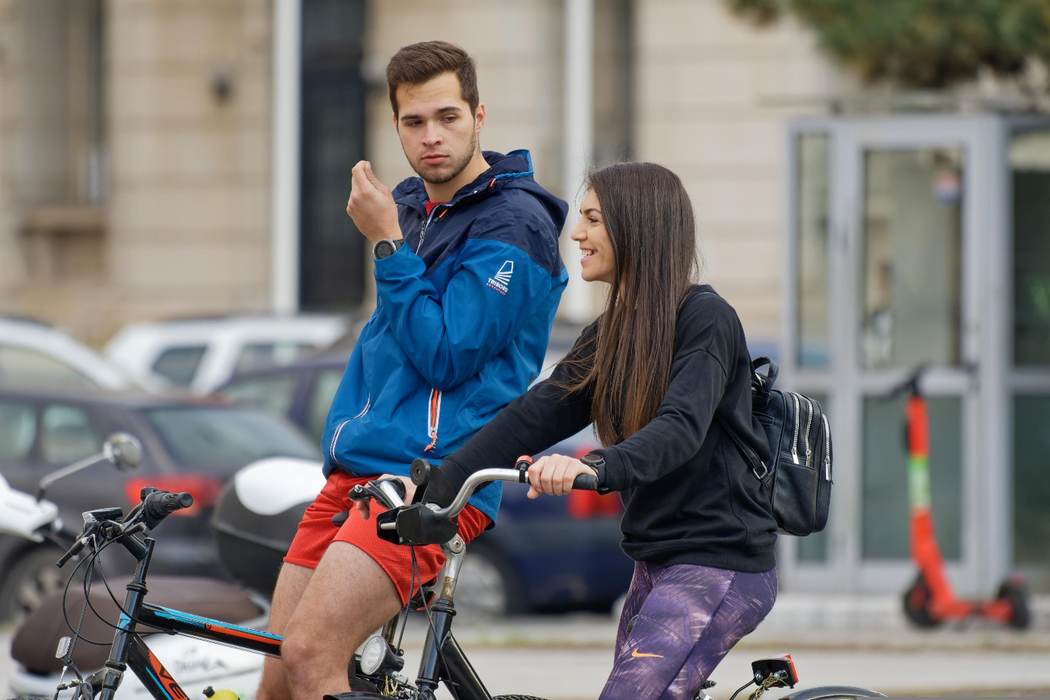
Application Scenario Expansion
Hands occupied
Bike ride

Slide 22

Q & A

Slide 23



